Slide 1
Library preparation

Slide 2
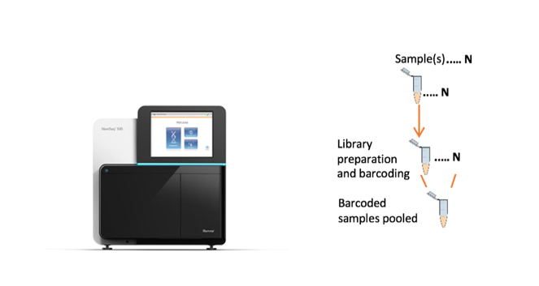





Library preparation
The process of converting DNA samples into a form suitable for sequencing.
Quantification & pooling

Slide 3
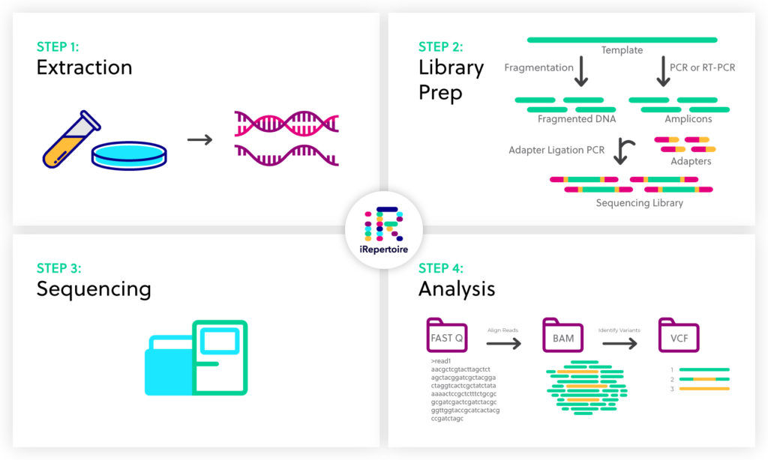

Slide 5
DNA/RNA extraction
The process of isolating nucleic material from the cell
Cell lysis
Nuclei acid recovery
Nucleic acid purification

Slide 6
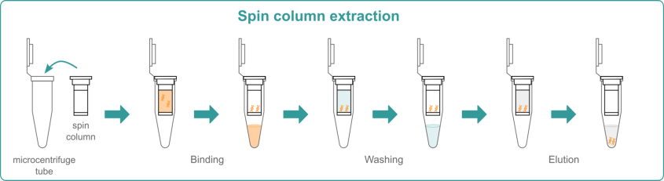
DNA/RNA extraction
Cell lysis
Nuclei acid recovery
Nucleic acid purification

Slide 7
Considerations for nucleic acid isolation for NGS
Yield: Nanograms (ng) to micrograms (µg) of DNA or RNA are usually required for library preparation.
Purity: Isolated nucleic acid should be free of compounds that can inhibit enzymes during library preparation.
Reagents from extraction (e.g., phenol, ethanol)
Contaminants (e.g., heparin)
Quality: The integrity and quality of isolated nucleic acids is another important aspect for NGS success.
Isolated nucleic acid should be of high molecular weight and intact.
Spectrophotometry - measures A260, A260:A280 ratio, and A260:A230 ratio for purity and yield - Nanodrop
Gel-based methods - determines fragment size, distribution, and quantity - Tapestation

Slide 8
Types of NGS sequencing methods
Whole genome sequencing - Whole genome sequencing involves sequencing the entire genome of an organism, providing a comprehensive view of its genetic makeup. Includes both coding and non-coding regions in the genome.
Targeted sequencing - Targeted sequencing involves selectively sequencing specific regions of the genome rather than sequencing the entire genome. Used when one is interested in analysing particular genes or genomic regions.
Whole exome sequencing – Targeted sequencing approach which sequences specific regions of the genome that are protein coding (exons).
Whole transcriptome sequencing – Sequencing the total mRNA molecules in a cell. Gives insights of the expression levels of genes in a cell.

Slide 10
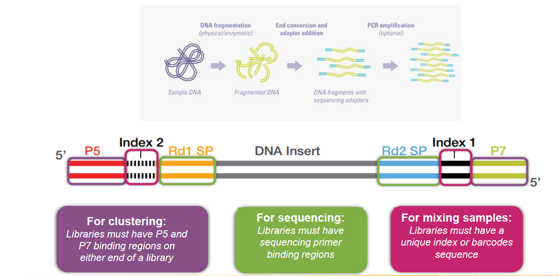
The aim of library prep is to obtain small DNA fragments with adapters attached on both ends
Notes:
The RB transcript is encoded in 27 exons dispersed over about 200 kilobases (kb) of genomic DNA. The length of individual exons ranges from 31 to 1889 base pairs (bp). The largest intron spans greater than 60 kb and the smallest one has only 80 bp.

Slide 11
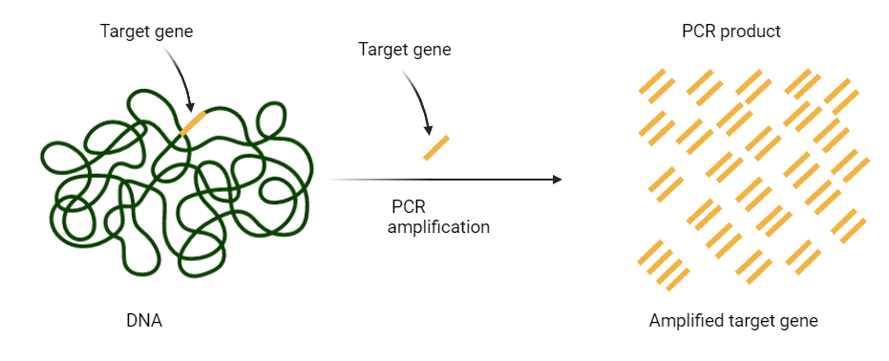
Steps in library preparation 1. Target gene amplification
To sequence specific genes, sets of related genes, or targeted regions of a genome.
More reads, better coverage, and higher depth, and therefore improved detection of rare variants at a lower cost than WGS.

Slide 12
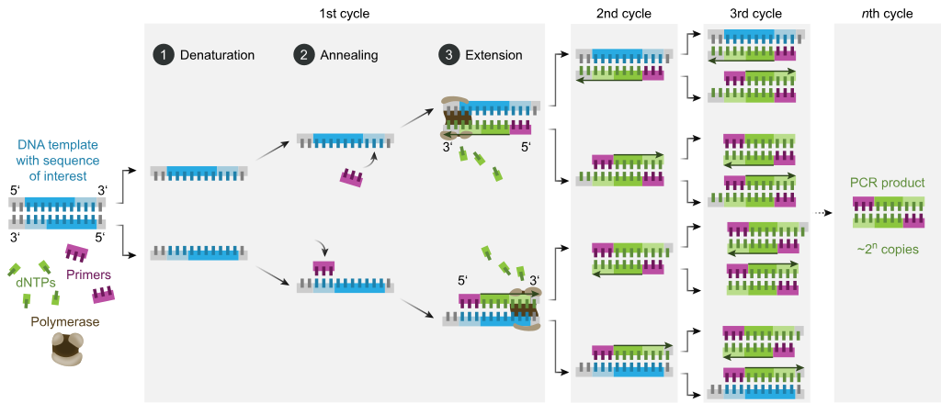
Steps in library preparation 1. Target gene amplification

Slide 13
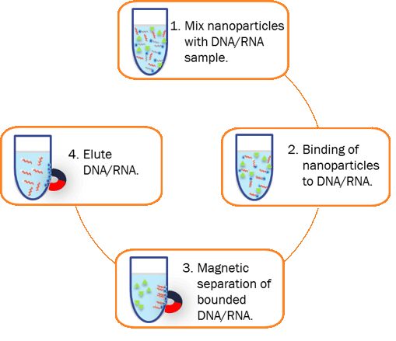
Steps in library preparation 2. PCR product clean up
Uses magnetic beads
Removes free primers and primer dimers from the amplicons

Slide 14
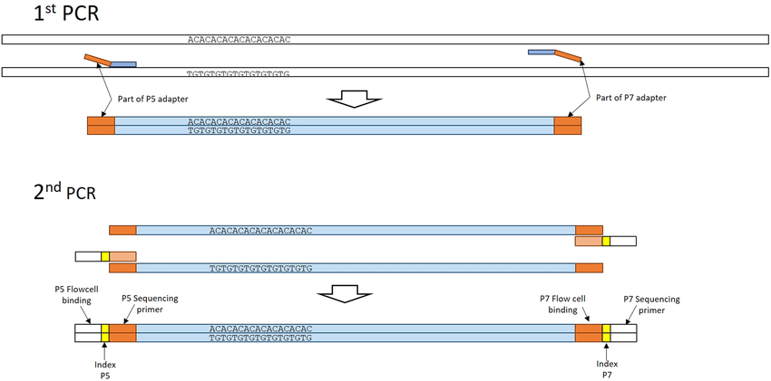
Steps in library preparation 3. Indexing PCR
Attaches indexes and sequence adapters

Slide 15
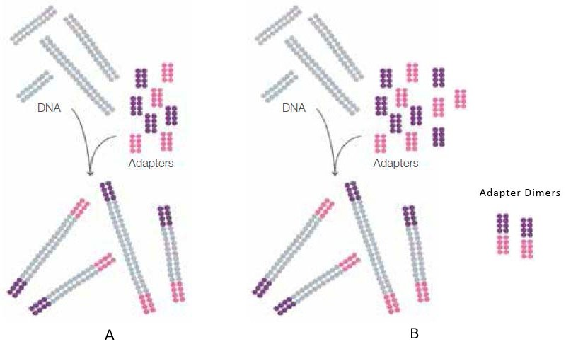
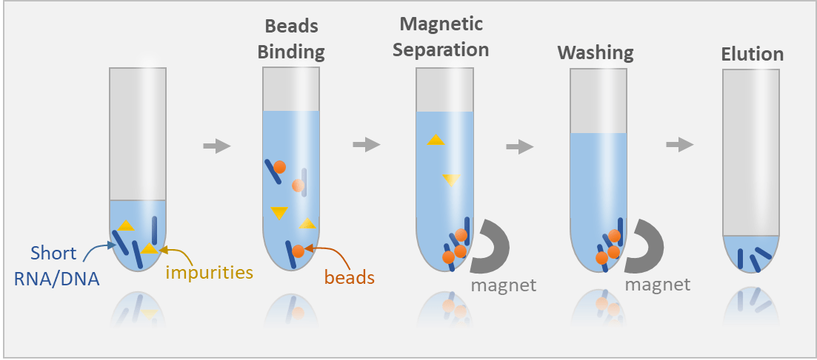
Steps in library preparation 4. Library clean up

Slide 16
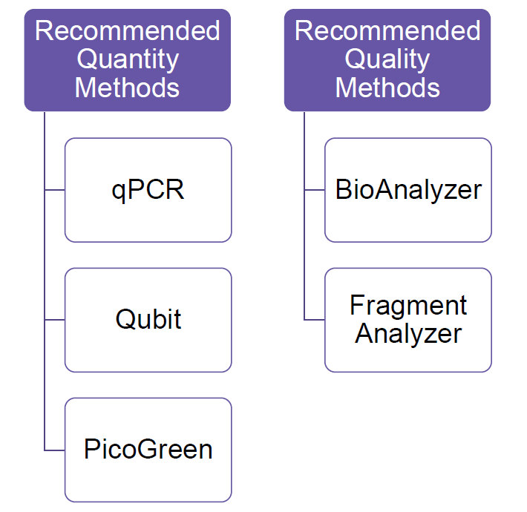
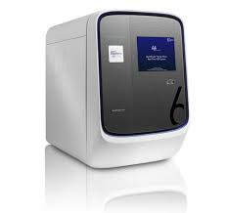
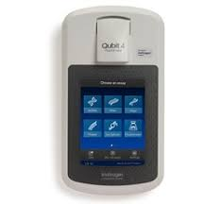
Steps in library preparation 5. Quantification
Accurate quantification of quality
libraries is critical for optimal cluster
density and data quality
This step of quality control helps ensure consistent data output and quality, as well as efficient use of the sequencing chips

Slide 17

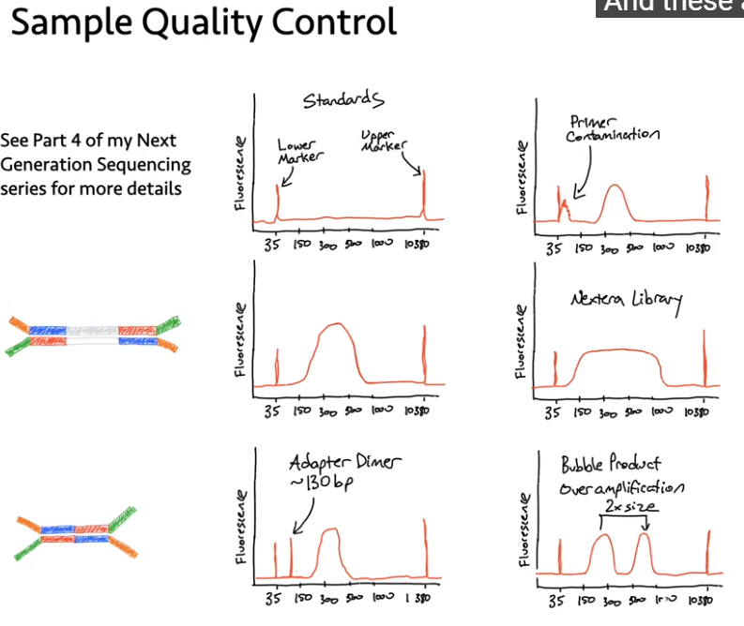


Slide 18
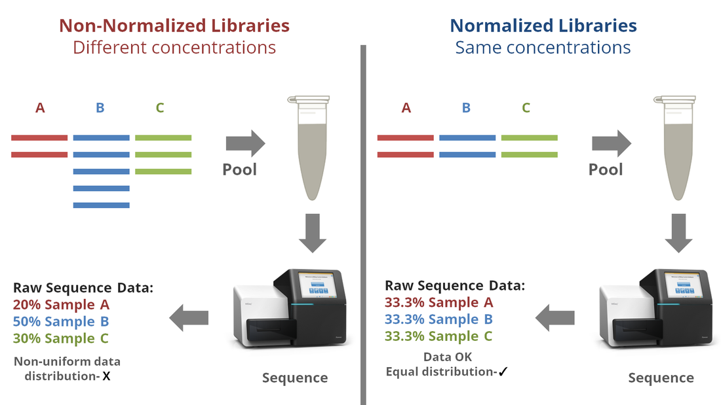
Steps in library preparation 6. Normalization and pooling
The process of equalizing the concentration of DNA libraries for multiplexing.

Slide 19
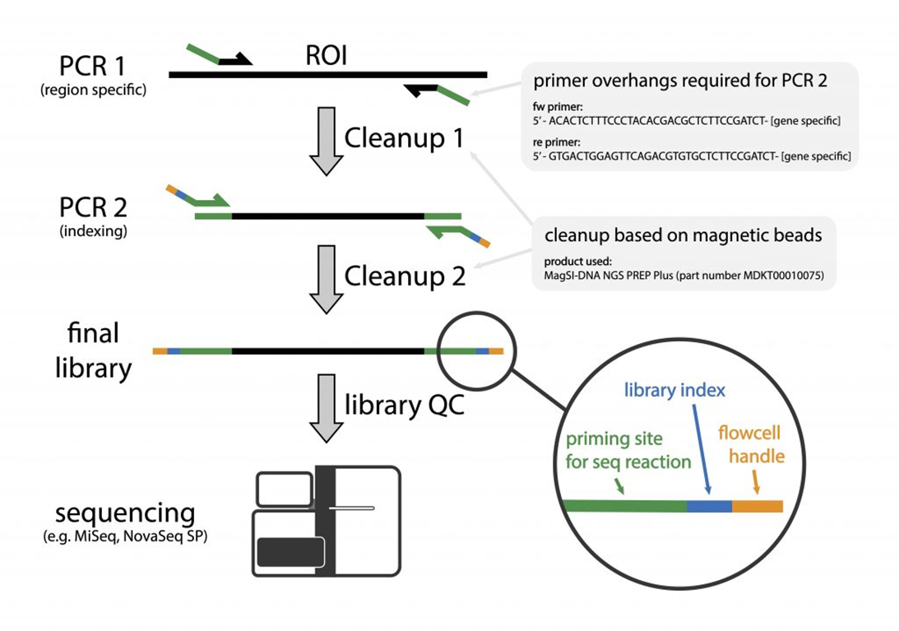
Steps in library preparation - Summary

Slide 20
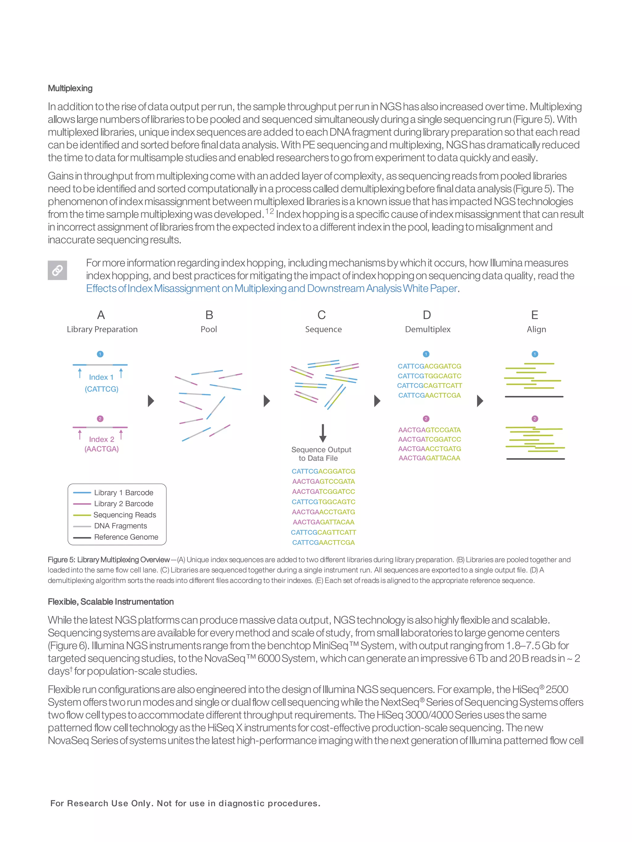

Slide 22






